Slide 1
A mini project on PREDICTION OF STORE SALES
presented by:-
Narmula vamshikrishna

Slide 2
Business goal:-
To predict the Sales of the products of different stores using the past data.
By analyzing the past data we have to build the model to predict the Sales of different products across different stores across different city/country.
By analyzing if the Sales made are more, the revenue will be more.
This will also lead to the increase in opening of more store branches across City or Country.

Slide 3
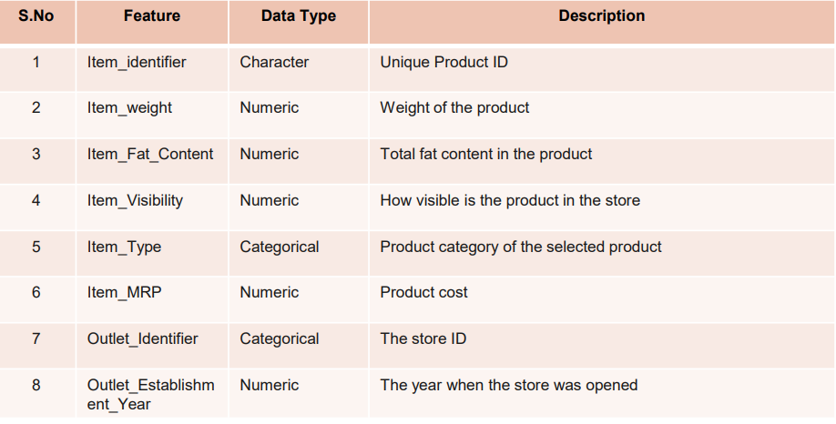
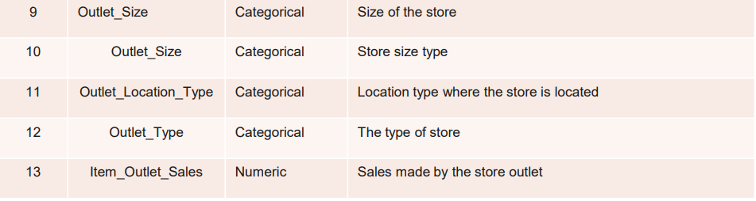
Data source and datatypes
The structure of the given dataset :
Rows = 14204
Columns = 12
The datatypes of the 12 features are shown in the picture which has
5 – Numeric columns
7 – Non_Numeric Columns

Slide 4
Data preprocessing : Imputation of missing values
Check for the Null values in the given dataset.
There were 40% of null values in a feature in the given dataset.
To impute these null values I used the ‘LinearRegression’ algorithm model to predict the null values and imputed the predicted values in the place of null values.
Firstly, I broke the data into two datasets
Dataset with no null values
Dataset with a feature full of null values.
I have done all the data pre-processing steps like
Converting non-numeric columns to category columns for the 2 datasets
Converting the category columns to numeric using the label encoder technique for the 2 datasets.
Scaling the 2 datasets by using standardisation technique by dropping the features to be predicted.
After scaling the data concated the dropped features to the respective scaled datasets.

Slide 5
Continue....................
After concating with the respective datasets I have used the hold out method (train-test-split) to split the dataset without the null values into train data and test data.
Splitted the dataset with test_size = 30% and random_state=42.
Splitted the dataset into X_train, Y_train, X_test, Y_test.
Model building using the LinearRegression algorithm.
Fitted the train data's to the model and checked for the performance of the train and test data.
After fitting the data to the model predicted the null values by passing the scaled dataset with null values.
After predicting the Sales null values assigned the predicted null values to the null values feature in the dataset.
After assigning the predicted values concated the two datasets to make it into a single original dataset.

Slide 6
Eda process:-
Loading the data and reading the data.
Check for the structure.
Check for the datatypes
Check for information
Check for summary
Check for null values.
Imputed the null values by building the LinearRegression model and predicted the null values.
Checked for any special characters present in the data found no special characters.
Data Visualization.

Slide 7
Feature engineering Techniques
Handling the Missing values.
Converting the non-numeric columns to categorical columns.
Using labelencoder converting the categorical columns to numerical columns.
Using standardization scaling the data
Finding the correlation of scaled features with for the dependent feature.
Feature selection based on the correlation with the dependent feature above 5%.
After feature selection specified the data into independent ‘X’ and dependent ‘y’.
Using the cross validation technique and KFOLD split technique the data is further splitted in the process of model building and evaluation.

Slide 8
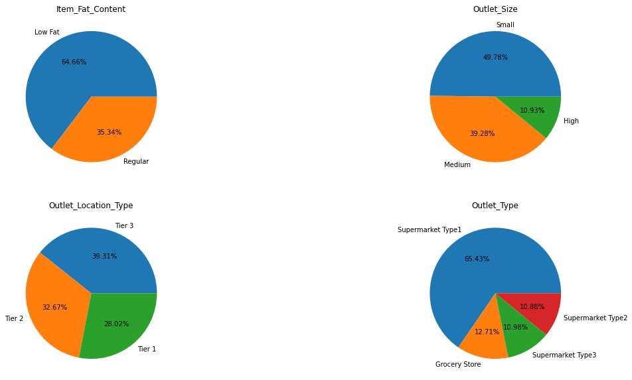
Visualizations:-
There are more items with ‘Low fat content’ with 64.66%.
There are more number of outlets with ‘Small size’ as 49.78%.
There are more number of outlets with ‘Supermarket Type1’ with 65.43%.
The outlets are more in the location type of ‘Tier-3’ as 39.31%.

Slide 9
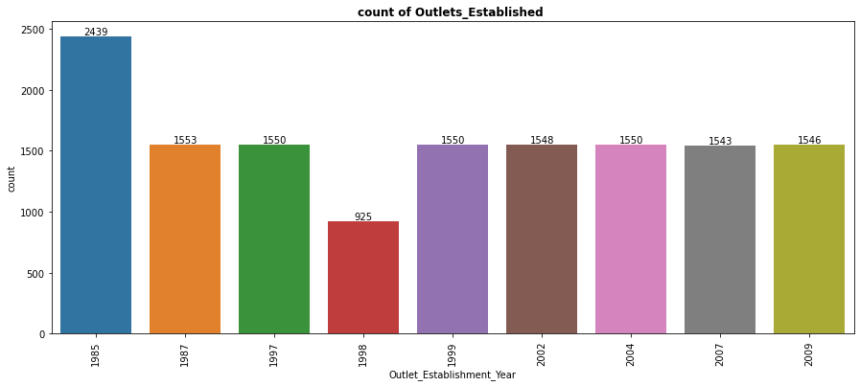
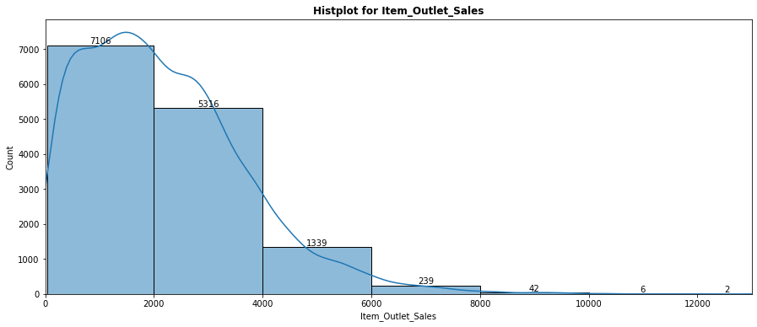
UNIVARIATE:-
The outlets established are more in the year 1985 and least in the year 1998.
Other than 1985 and 1998 the outlets established for each year varies between 1-5 outlets.
90% of the item_outlet_sales lies before 4156.196 and remaining 10% of the sales lies after 4156.196.
The count of the item outlet sales are more in between the range of 0 – 2000.

Slide 10
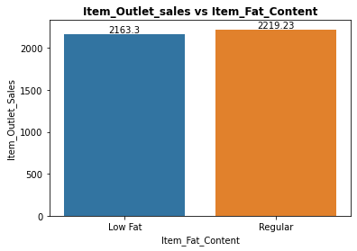
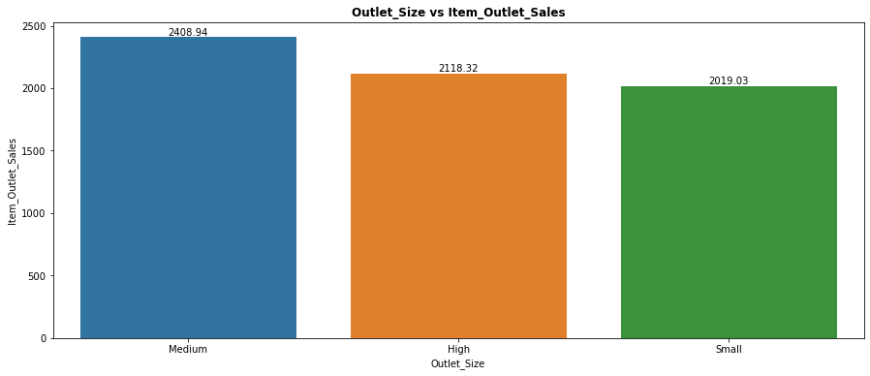
Bivariate:-
The Outlet sales are mostly for the Outlets of medium size followed by outlets with high size and lastly small size outlets.
The items with 'Regular fat’ content have more sales than the items with 'Low fat' content.

Slide 11
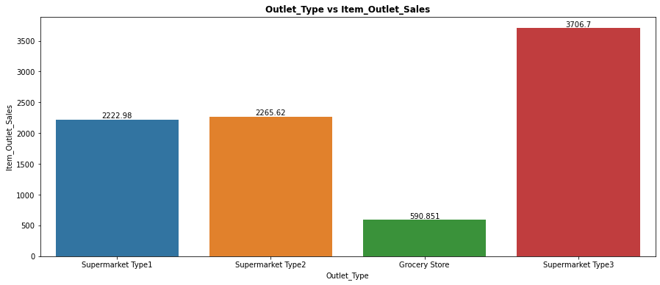
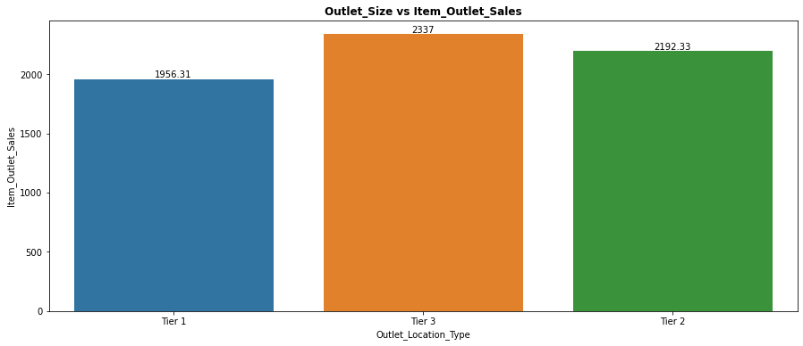
Bivariate
The Outlet sales are more for the Outlet types of Supermarket Type-3 and least in the Grocery store.
The Outlet sales are more for outlets in Tier-3 Location and least in Tier-1 Locations.

Slide 12
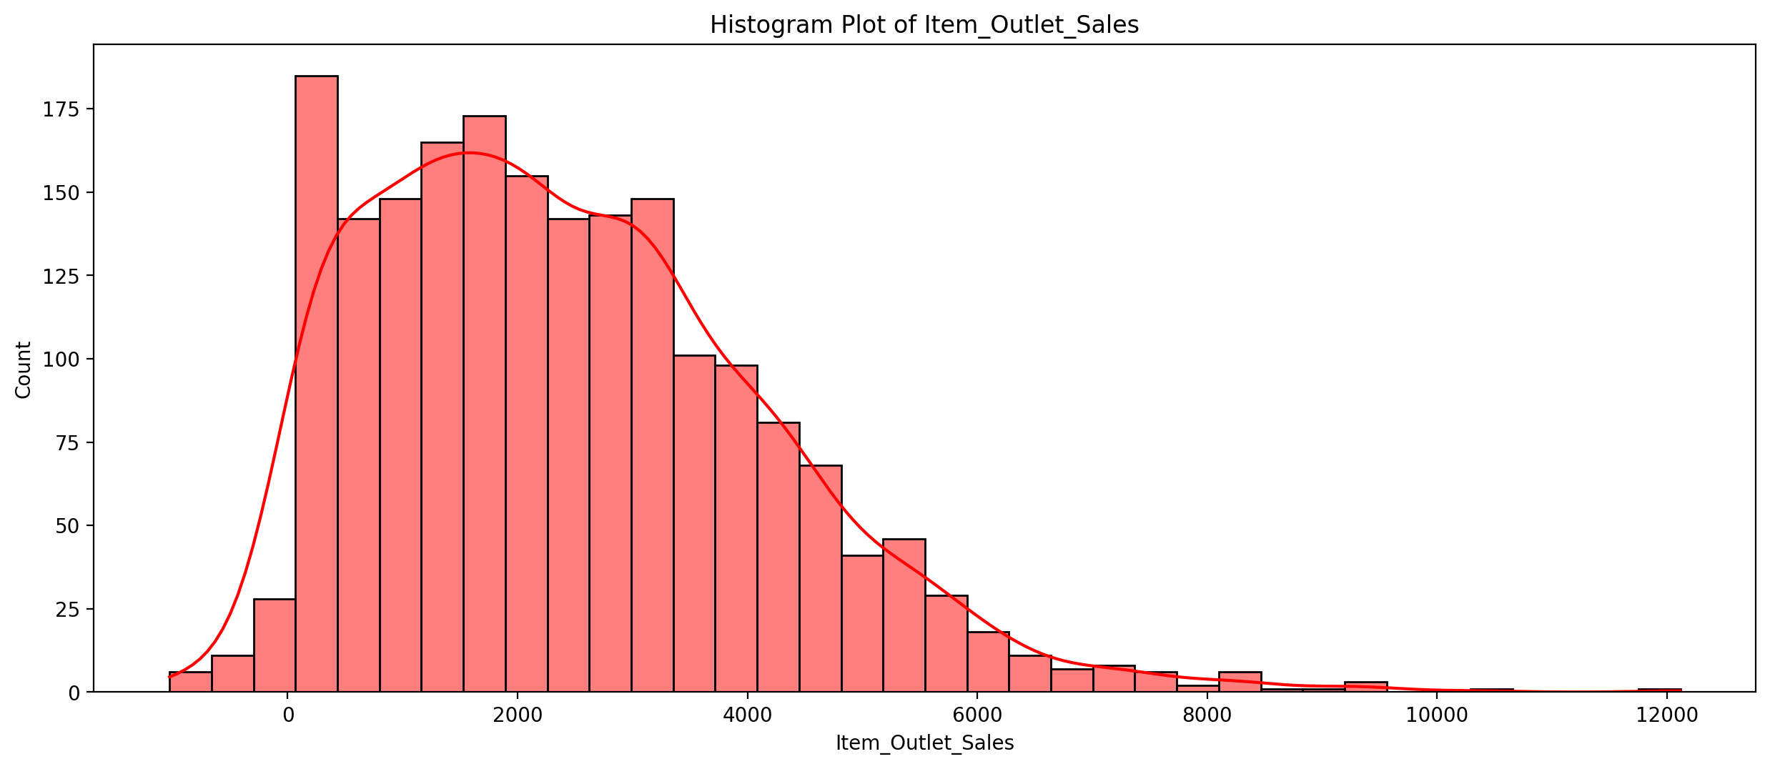
MULTIVARIATE
For the 'Medium Outlet_Size' with items with 'regular Fat Content' have the 90% of Outlet_Sales below the range 4671.56

Slide 13
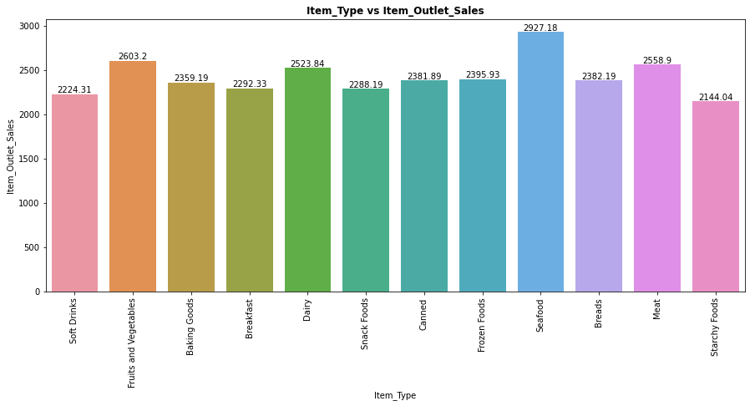
MULTIVARIATE
For the 'Medium Outlet_Size' and items with 'regular Fat Content' the outlet sales are more in for the Items 'Seafood’, 'Fruits and vegetables’, 'Meat' and 'Dairy'.

Slide 14
Model building
For model building I have used 5 algorithms
As the problem statement is regression problem I have used these 4 regressor models.
I have used these algorithms to check which model gives the best metrics performance for the given dataset.
1. RANDOMFOREST REGRESSOR
2. LINEAR REGRESSION
3. DECISIONTREE REGRESSOR
4. XGB REGRESSOR

Slide 15
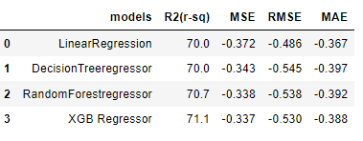
performance check for all the 4 algorithms
The XGB Regressor performance is better compared to other algorithm models.

Slide 16
Final Model
From the Metrics performance I have considered the final model as XGB Regressor.
R_sq = 71.1%
RMSE = 0.530
After checking the performance of all the algorithms using cross validation technique it is found that the
‘XGB Regression' algorithm model gives the best Performance.
The coefficient of determination(r-square) of XGB Regression model is 71.1%.
The performance of the Model is 'Good'.
After the evaluation of metrics by the XGB regressor model using cross validation technique i further split the data using the holdout method to carryout the performance on train data and test data and make predictions.
I have split the data by using train test split taking the test size = 30% and random state = 42.
I have fit the train data to the model.
I have checked the score for train data and test data.
The performance of the train data is 68.1%.
The Performance of the test data is 66.8%.
For both the train and test data the performance is nearly same and the model performance we can say is 'good'.
I have predicted the Outlet_sales using the X_test and plotted the graph for actual and predicted values.

Slide 17
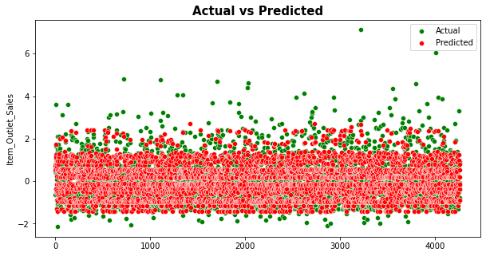
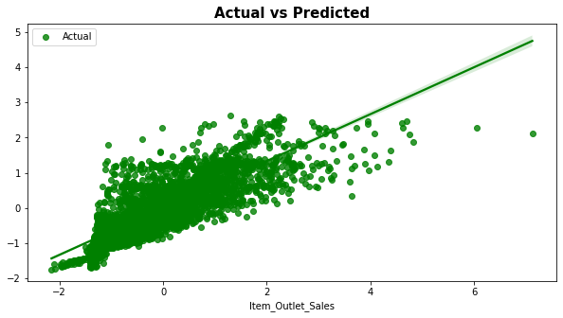
The actual values and predicted values difference is very less.
From this plot we can say that the actual test data points and predicted test data points are nearer to the best fit line except some points which are considered as outliers.

Slide 18
Business Conclusion:-
The Outlets mostly contains the ‘Low fat content’ items but the sales are more for ‘Regular Items’ so concentrate mostly to improve the regular items.
The most of the outlets are with ‘small size’ but the sales are more in the ‘Medium size’ outlets, so concentrate mostly to increase the medium size outlets.
The most of the outlets with outlet type of ‘Supermarket type1’ are more but the sales are more in the ‘Supermarket type-3’, so concentrate to increase the supermarket type-3 outlets.
The outlets are more in the ‘Tier-3’ location and the sales are also more in ‘Tier-3’ location type outlets so concentrate to increase the outlets in tier-3 location.
For the 'Medium Outlet_Size' with items with 'regular Fat Content' have the 90% of Outlet_Sales below the range 4671.56.
For the 'medium Outlet_size' and items with 'regular fat content' the outlet sales are more in for the items 'seafood’, 'fruits and vegetables’, 'meat' and 'dairy'.

Slide 19
Thank you

